Slide 1
GJK
Origin Overlap
Game 256

Slide 2
Overview
Review building simplices
Triple Cross Product
Tetrahedron Origin Containment

Slide 3
Review building simplices
Building a point
Processing a line
Processing a triangle
Processing a tetrahedron
Determining origin overlap

Slide 4
Building a Point
Choose a starting direction
Get the support point given that direction
Add that point to the simplex

Slide 5
Building a Point

Slide 6
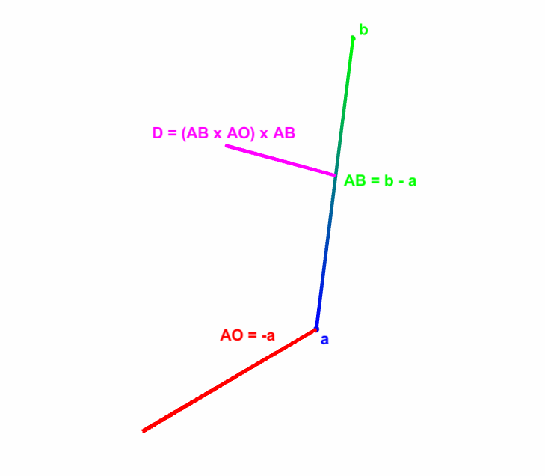

Processing a Line
Get the line AB, where A is the newest vertex and B is the oldest vertex.
$AB=B−A$
Get the direction to the origin from A.
$AO=−A$
Build a vector perpendicular to AB in the direction of the origin.
$D=\left(AB×AO\right)×AB$

Slide 7
Let’s explain the Triple Cross Product
Since we will be using it a lot.

Slide 8

Triple Cross Product
The triple cross product is used when you need a vector that is perpendicular to a vector, and in the direction of another vector.
($a×b)×a$

Slide 9
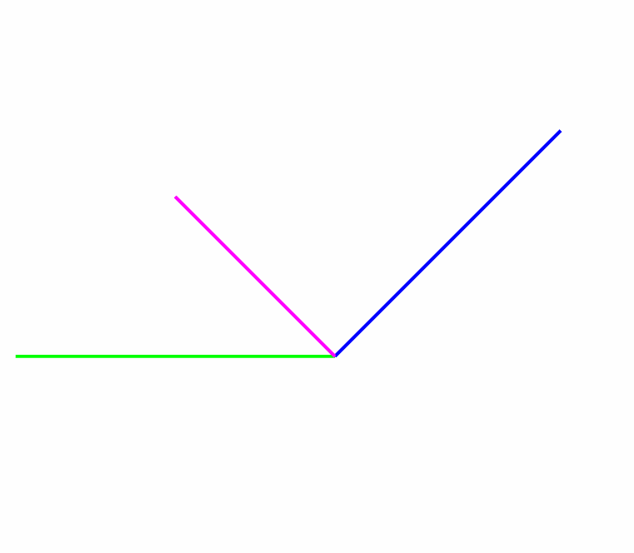

Triple Cross Product
$v=\left(a×b\right)×a$
Yields a vector perpendicular to $a$ in the direction of $b$.

Slide 10
Okay, continuing
With processing a triangle, if you don’t recall.

Slide 11
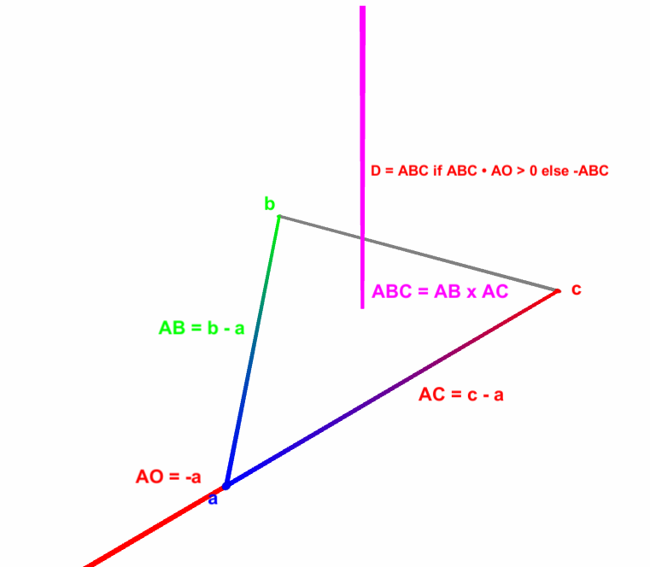

Processing a Triangle
Get the line AB, and AC, where A is the newest point, B the second oldest, and C the oldest.
$AB=B−A$ $AC=C−A$
Get the line ABC perpendicular to AB and AC
$ABC=AB×AC$
Get the line AO
$AO=−A$
If ABC is in the same direction as AO
  $0<ABC ∙AO$
  Get the vector perpendicular to ABC in the direction of AO
  $D=ABC$
Otherwise invert it
$D=−ABC$

Slide 12
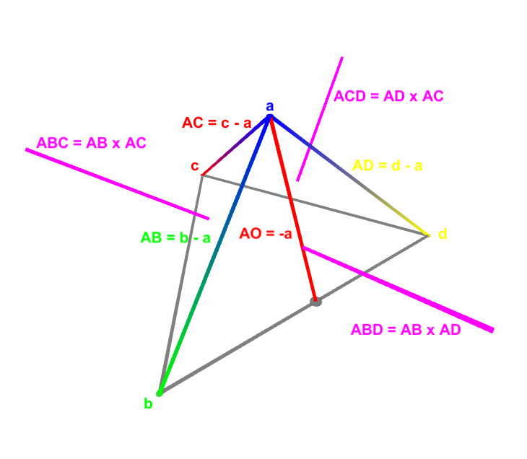

Processing a Tetrahedron
Much like triangle we need to get the face normal for all 3 new triangles ABC, ABD, and ACD.
$ABC=AB×AC$
$ABD=AB ×AD$
$ACD=AD ×AC$
Then check if ABC, ABD, and ACD are in the same direction as the origin AO
$AO=−a$
$0<ABC ∙AO$
  Remove d
Else, $0<ABD ∙AO$
  Remove c
Else, $0<ACD ∙AO$
  Remove b
Else, origin is inside the tetrahedron.

Slide 13
Tetrahedron Origin Containment
Okay, so what is happening here?
If the direction to the origin is in the same direction as ABC, ABD, or ACD.
Then the origin isn’t inside the tetrahedron.
And we should look in the direction corresponding to the triangle we just checked.
Use Process a Triangle for that.

Slide 14
Up Next
Resolving a collision with GJK

Slide 15
Fin

